Slide 1
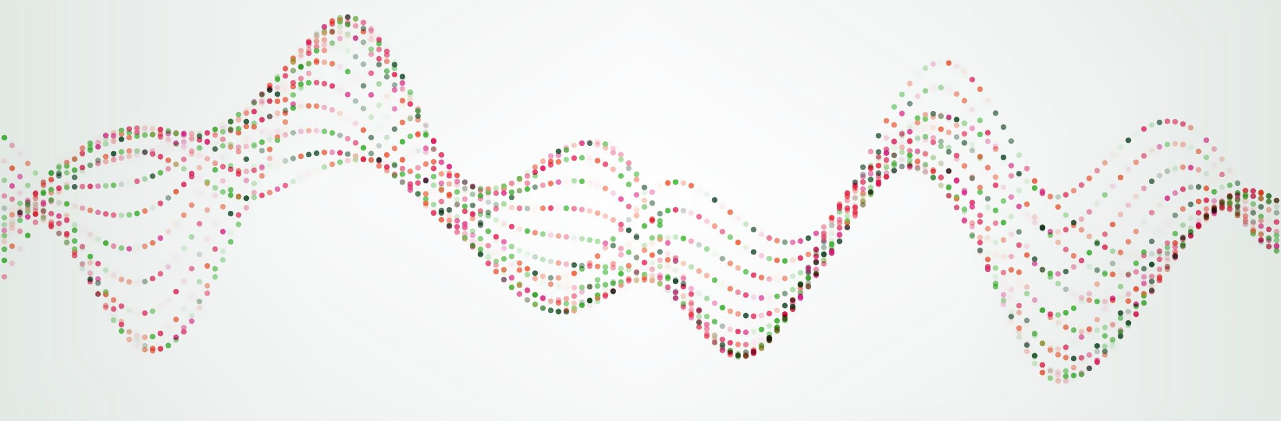
POVS AND EXPERIENCE PROTOTYPES
Asa Kohrman, Marco Pizarro, Max Vandervelden
Notes:
https://www.vox.com/2015/8/10/9118199/public-transportation-subway-buses
https://www.comparabus.com/en-us/bus-companies
https://www.the-backpacking-site.com/transport/usa-by-bus/

Slide 2

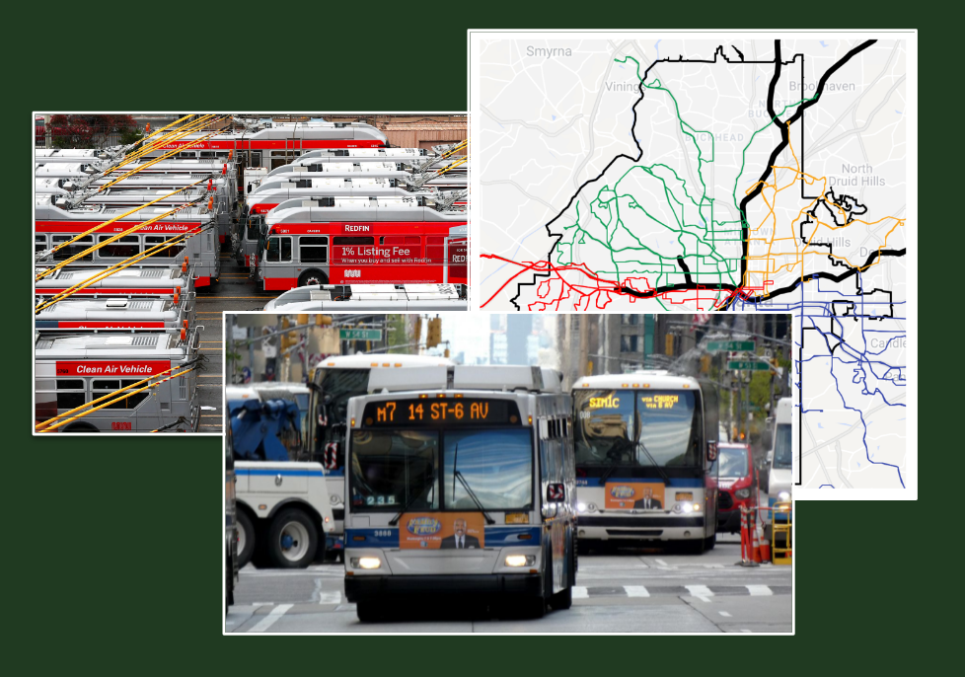
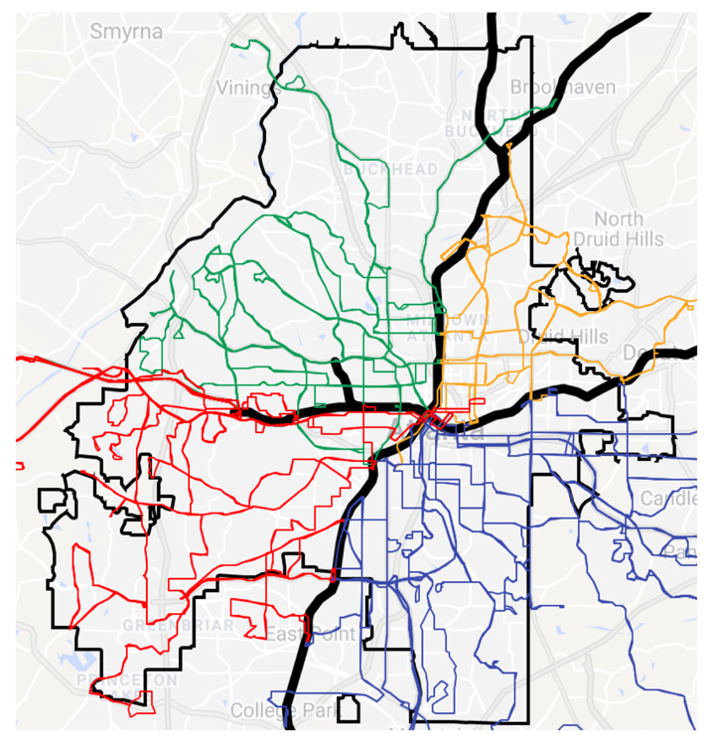

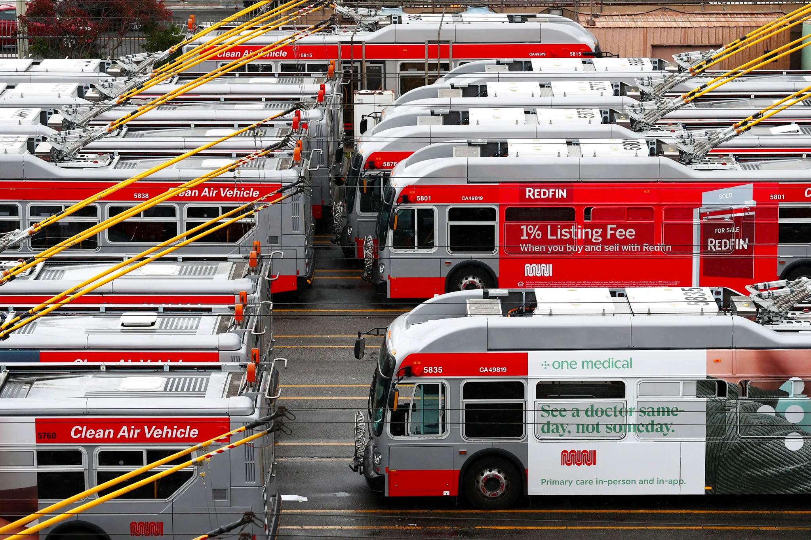
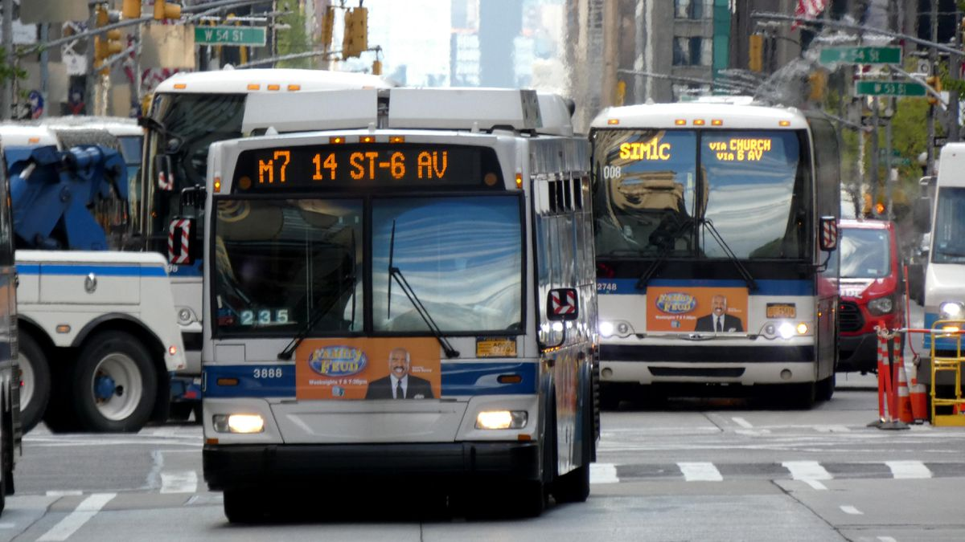

Problem Domain:
Bus Systems and Networks
Max V
Asa K
Marco P
Notes:
Someone who would benefit from using the bus
Someone who has a difficult time finding a bus route that works for them
Someone who wants to travel a longer distance, for example, on a daily commute from the suburbs into downtown
Someone who enjoys the social and emotional experience of taking public transit

Slide 3
Marina POV
We met Marina, a commuter in her early-20s without a license who heavily uses public transportation
We were surprised to notice that she still checks the route after taking it daily
We wonder if this means that the buses and trains she uses are inconsistent and the transfers are stressful
It would be game-changing to have consistent schedules that line up between buses and trains

Slide 4

“Reading the map that Google Maps gives you can be confusing”
“It doesn't match what the signs at the stations say, and that’s why I got mixed up”
“You experience a lot more different people… it can be scary”
“You just gotta mind your own business”
Atlas
SFSU student who uses public transportation & Uber to get around
Average User
Notes:
Needfinding Round 2

Slide 5

“Figuring out the bus system just isn’t worth it for me.”
“The timing is always bad. They don’t sync up. A bus will arrive at a station two minutes after a shuttle leaves for campus.”
James
GT student who primarily uses a car
Non-User

Slide 6

“In NYC, I only take public transportation.”
[In GA]
“The suburbs …are super spread out. Really, there’s no option, … there’s no bus.”
Buses are one of the only ways to get in between boroughs.
Sarah
NYU student who primarily uses the NYC (Manhattan) subway system
Average User

Slide 7

POV 1
We met Elsa, a Stanford student in her 20s. She’s a former tech employee who used an Apple shuttle instead of taking the train.
We were surprised that despite having the Apple shuttle available, she wishes she could take public transit, because it takes her out of natural social circle.
We wonder if this means that she wants a more social transit experience.
It would be game-changing to make a way for more people to interact on their commute.
Elsa

Slide 8

POV 2
We met Marina, a commuter in her early-20s without a license who heavily uses public transportation
We were surprised that she has been hit on and sexually assaulted on the train, sometimes even by the same person.
We wonder if this means she constantly feels unsafe on public transportation
It would be game-changing to give her more peace of mind during her commute.
Marina

Slide 9
POV 3
We met Sarah, an NYU college student who exclusively uses public transit in NYC.
We were surprised to notice that she frequently takes the subway but the bus once because of complicated schedules and poorly indicated lines.
We wonder if she feels limited in her ability to explore since she entirely takes the mainly North/Southbound subway.
It would be game-changing to reduce the learning curve and difficulty involved in exploring other metropolitan centers.
Sarah

Slide 10
HMW make spontaneous interactions feel normal?
Notes:
HMW indicate different passengers who want to talk?
HMW create alerts for performers on the train?
HMW improve waiting for the train/bus?
HMW connect people going to the same place?
HMW encourage more social people to take the train?
HMW get people off their phones in public transit?
HMW help people connect while they are waiting for public transit?
HMW coordinate friends meeting up on public transit?
HMW suggest social activities for passive time on the train?

Slide 11
How might we make buses as low effort as possible?
Notes:
HMW make bus stations more useful to riders?
HMW tell users to get off of the train at the right stop?
HMW show users how to walk from stop to stop?
HMW improve trust with the bus systems?
HMW let people relax on bus/train while keeping them alert?
HMW make signs easier to understand?
HMW make missing a bus less stressful?
HMW provide the user alternative routes to the same destination?
HMW improve the reliability of bus systems?

Slide 12
HMW make getting help on public transit easier?
Notes:
HMW give her a sense of where she is relative to what she knows?
HMW improve the already existing ferries?
HMW improve the already existing underwater transit line (that nobody uses)?
HMW make her trip have less distractions/more focused?
HMW bring everything worth exploring into Manhattan?
HMW make the trip (feel) instant?
HMW crowdsource routes taken by others under similar conditions to the same destination?
HMW eliminate all the planning involved?
HMW make learning about transit options the most exciting part of the experience?
HMW make missing your stop easy to recover from?
HMW we design a way to have the bus driver/passengers answer her questions without her having to ask in-person?

Slide 13
Solution 1
Critical Assumption
A safety feature allowing you to share your ride and progress with a friend.
Most people have someone trusted they would want to share their location with.

Slide 14
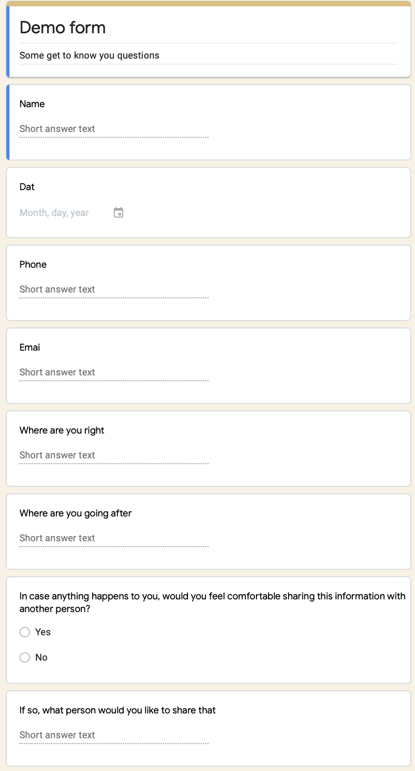


Experience Prototype 1
Do people have trusted contacts?
We created a form that asked name, phone number, and a person’s physical location. Then, we asked, in case anything happened to them during the interview, if they had someone they would like to share their information and location with.

Slide 15

Results
Things that Worked:
Both people shared their location with someone who would “freak out in the right way”
Surprises/Learnings:
Felt comfortable sharing with only one person
Notes:
They both immediately put one person down who they said would “freak out the right way” as opposed to a parent who would worry over nothing. This revealed that they both had one person who they really trusted to take care of them.

Slide 16
Solution 2
Critical Assumption
An intelligent GPS which gives real-time updates and suggestions before and enroute to a destination.
People won't memorize new routes before leaving.

Slide 17
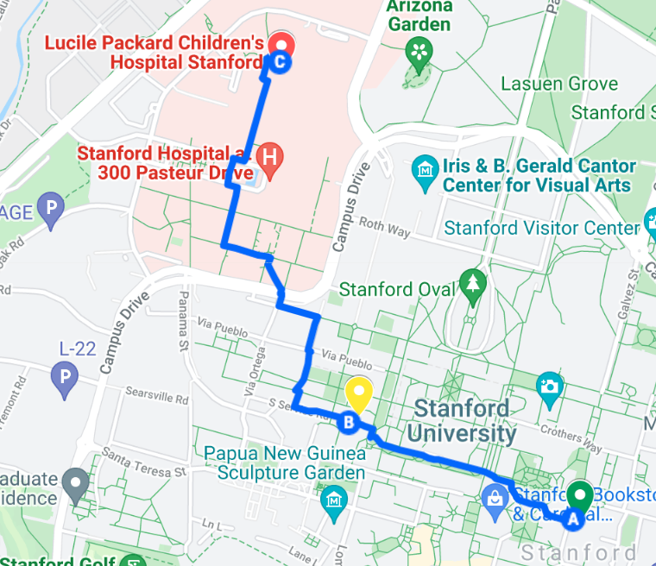
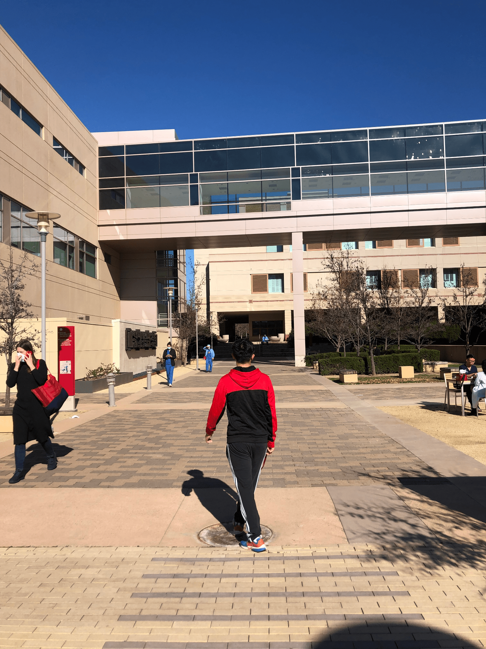
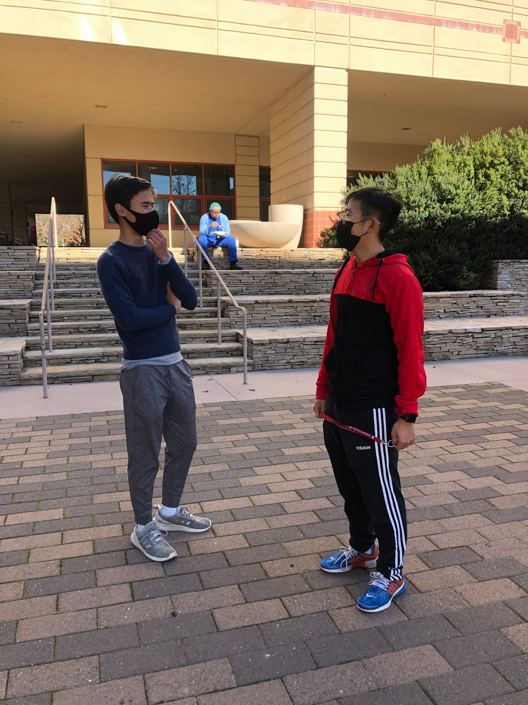
Experience Prototype 2
How can we test how people visualize and approach/plan new routes?
😄
😄
Plan a route with two relatively unknown locations of similar distances.
Follow them, see how they navigate. How often do they use their real-time location?
Interview them and ask about their experience afterwards.

Slide 18
Results
Things that Worked:
Confirmed that when exploring new areas people usually monitor their real-time location multiple times during the route in relation to their final destination
Easier to monitor phone/real-time data when less directed (i.e. when driving)
Things that Didn’t Work:
Initial route to McCullough almost entirely memorized beforehand, was able to locate based on remembering close-by buildings
Difficult to test scenario of navigating routes using specifically public transit
Surprises/Learnings
Real-time data mostly not needed when been in general area before, can orient

Slide 19
Solution 3
Critical Assumption
A chatbot that knows your location and can answer your questions during your ride.
People would want to interact with a chatbot instead of other ways of getting help.

Slide 20
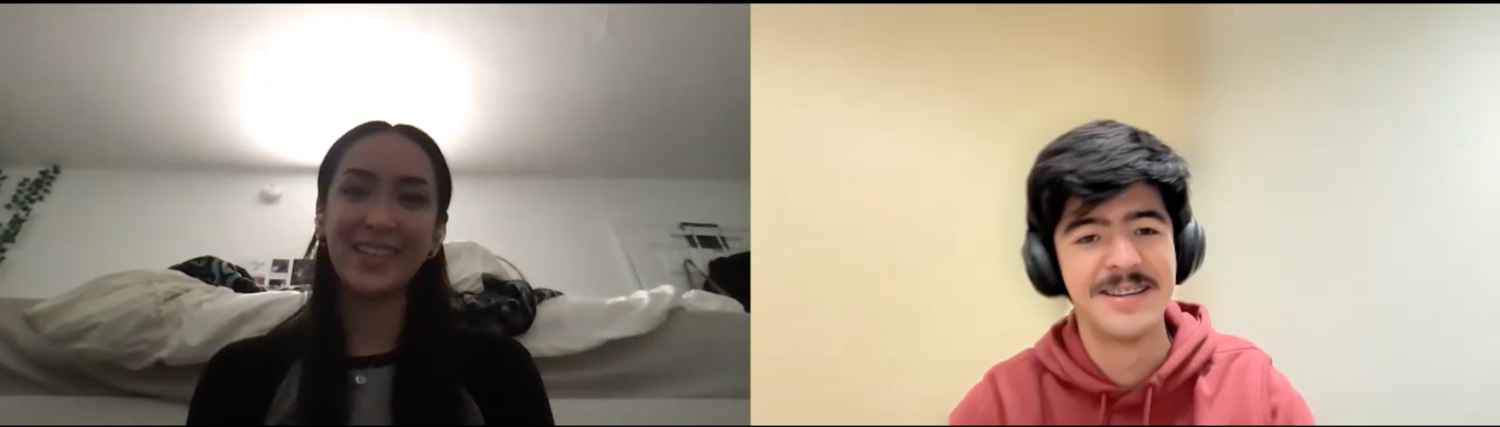
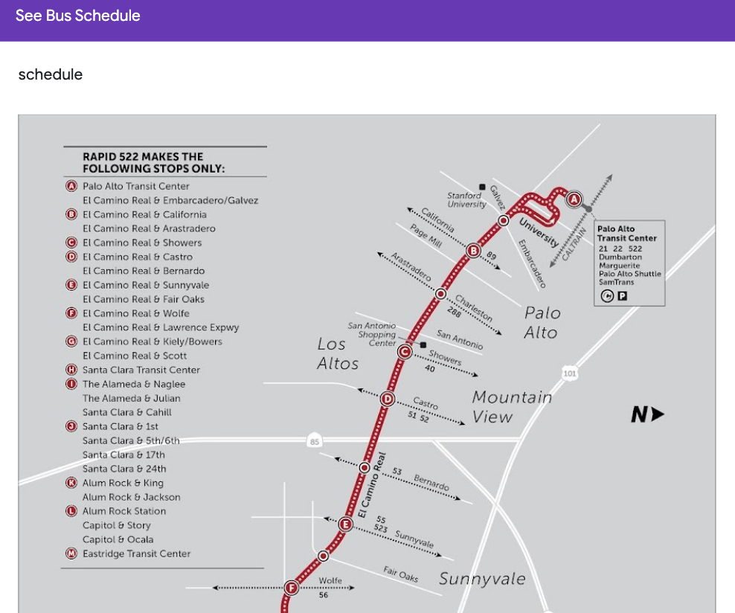
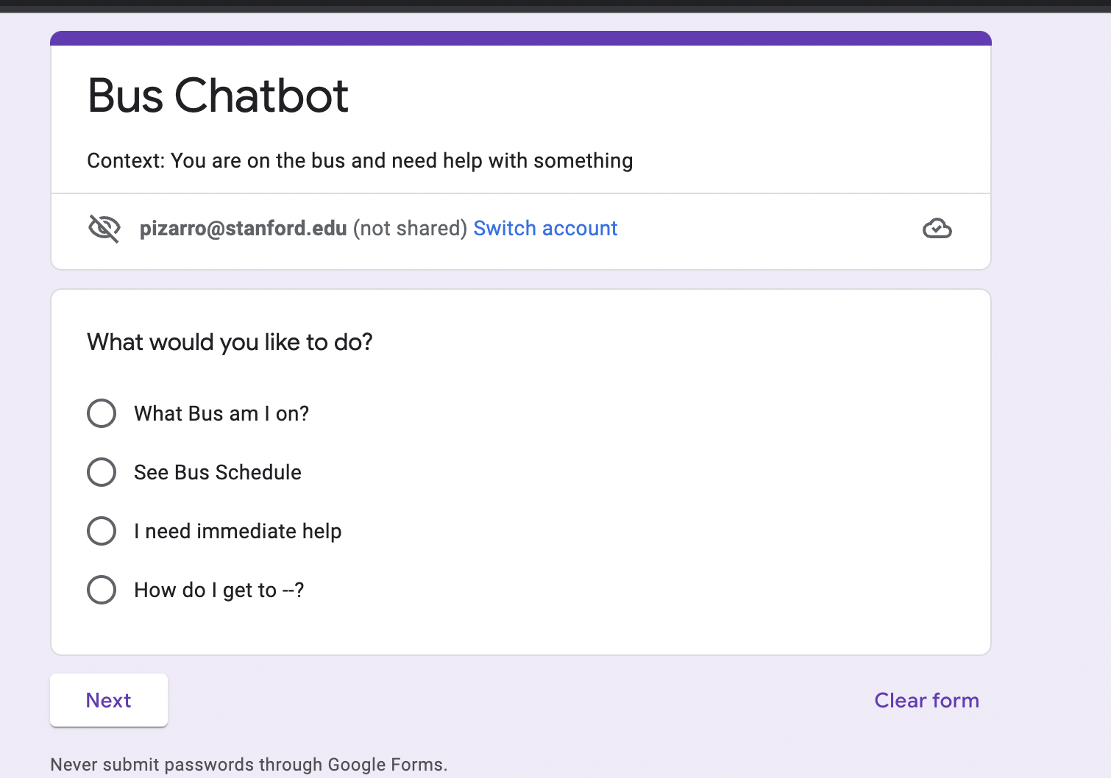

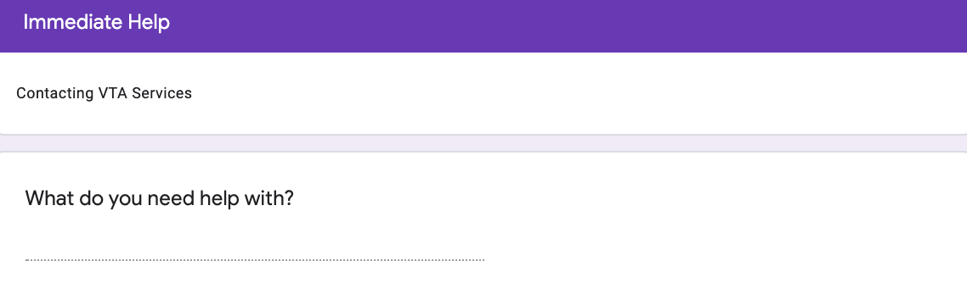
Experience Prototype 3
How can we test how people visualize and approach/plan new routes?
We tested this by creating a chatbot in Google Forms with set statements and asking users about their experience
Link

Slide 21


Results
Things that Worked:
Confirmed that people would even want to interact with a chatbot instead of other options
“It was certainly easier to see these options all laid out.”
Things that Didn’t Work:
“If the chatbot were to give me step by step instructions, I feel like that would eliminate a lot of confusion.”
“If there were an emergency I would probably just call 911."
Surprises/Learnings
May be less intuitive for older/less technologically-experienced users

Slide 22
Solution
We propose to combine Solution 3, the bus chatbot, with the real-time route planning features of solution 2
Who would be interested?
Those who don’t know how buses work
Those traveling longer distances who might otherwise only have a car as an option.
Those worried about their inexperience taking a new route
Who might this leave out?
People with little exposure to technology
Older people
People w/o cellphones or other devices
People with bad cell service on buses

Slide 23
Summary
Next Steps
While it confirmed our general assumptions, first prototype needs further testing of solution 1 for an actual public transit route to new areas
Solution would be most useful for exploring new areas, not general destinations
The second prototype was effective in proving user interest, and a more medium-fi prototype would effectively tackle our tester’s concerns
The third prototype proved users are willing to send a person their location and information when they feel unsafe but should be tested in a specific route scenario
Address the accessibility issues of our solution
Narrow our scope, question of how to implement these features in combination with each other
Build our website :)

